Slide 1
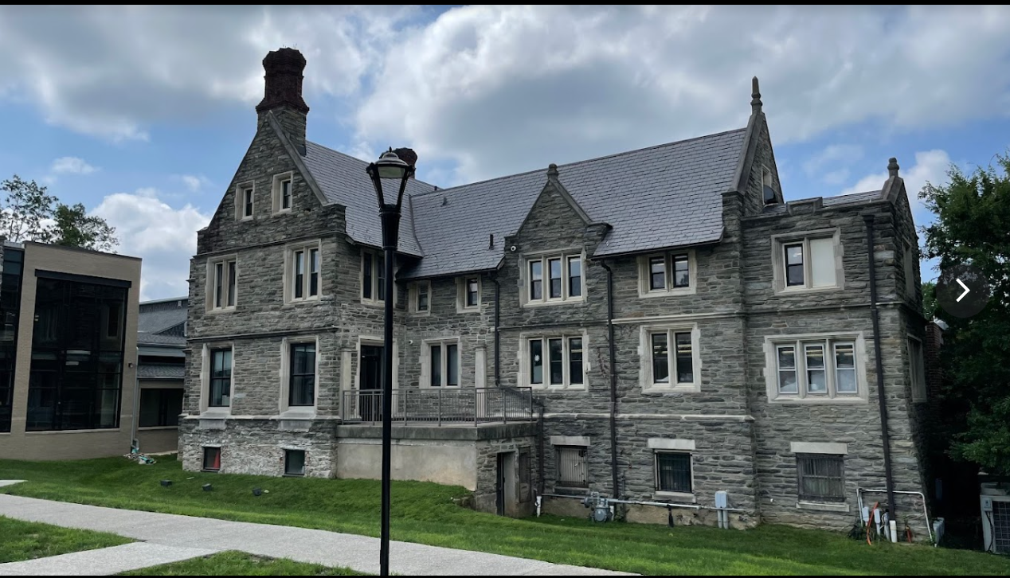
Beginner Chess Step-By-Step 2/1/24
Delaware Valley Chess Club
Kohelet Yeshiva

Slide 2
CHESS
Openings
Middlegame
End Game
The Dragon
The London
The Nimzo-Indian
Tactics
Mating Patterns
Steinitz Elements
Basic Themes
Basic Endings
Theoretical
Strategic
End Game
Middlegame
Openings

Slide 3
Curriculum
GOALS
Introduction for the absolute beginner
The pieces and how they move
The board and notation
Clocks and tournament chess
Review basic Endgames
Introduce Pawn Endgame Concepts – vocabulary with examples.
Introduce Rook Endgame Concepts – vocabulary with examples.
Introduce Basic Tactical Ideas
Introduce Basic Mating Attacks
Introduction to Positional Evaluation (Steinitz)
Learn a Repertoire for Black and White

Slide 4
Bibliography
Muller, Karsten; Chess Endgames for Kids, Gambit, UK, 2015
Chandler, Murray; Chess Tactics for Kids, Gambit, UK, 2003
Chandler, Murray; How to Beat Your Dad in Chess, Gambit, UK, 1998
Watson & Burgess; Chess Openings for Kids, Gambit, UK, 2011
Engqvist, Thomas; Chess Strategy for Kids, Gambit, UK, 2016
Chandler, Murray; Chess Puzzles for Kids, Gambit, UK, 2012

Slide 5
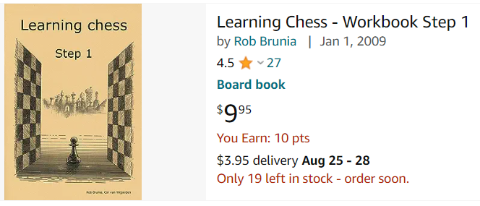
Resources
Lecture summaries can be found at www.delvalchessclub.com see MLSN tab.
Or go to www.chesstotor.eu
And download step 1 interactive
workbook.

Slide 6
The Most Famous Philidor Positions
Black to move and Draw
White to Move and Win
White to Move and Win

Slide 7
Delaware Valley Chess Club’s
Prestigious Philidor Medal
Francois-Andre Philidor (1726-1795) was a French chess player and author. He was arguably the first modern player with a real positional, not just tactical, sense. Best known for his focus on pawn play, he also has an opening, ending positions, and a checkmate pattern named after him. “Teach the teacher” the three
Previous positions and win the “Prestigious Philidor Medal”

Slide 8
Week 1 – 2/1/24
1 Resources and Bibliography
1. The Chessboard and Notation
2. How do the Pieces move and get their Power?
Review the King move and the button game.
The Knights Race
5. Review Pawn moves and Pawn promotion.
6. Basic Endgame 1 “What is Mate?” + Notation Record K & Q vs K Mate.
7. Introduction to the chess clock
8. Introduction to Opening Principles
9. Play Through a Demonstration Opening
Chess Board
Pieces
Endgame
Tournaments
Openings
Play

Slide 9
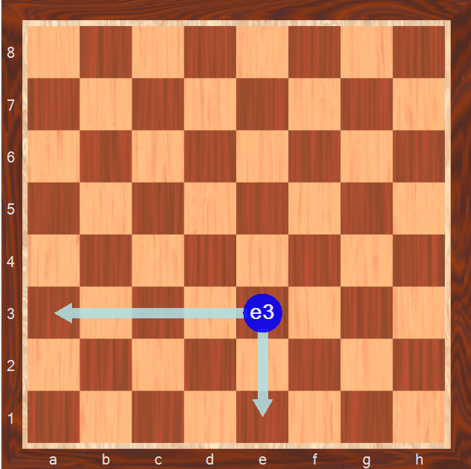
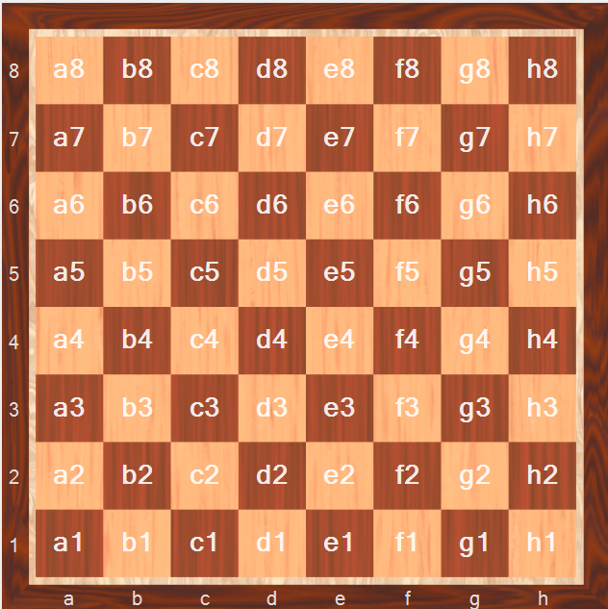
Chess Notation
An example of a Squares Name
All the Squares Names

Slide 10
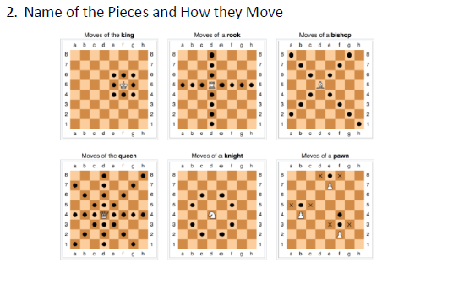
Week 1 - 2/1/24

Slide 11
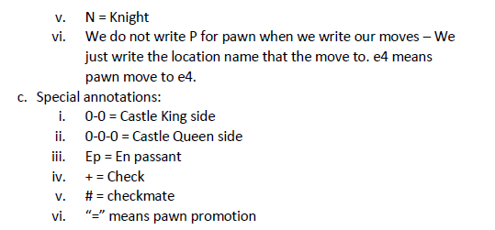
Week 1 – 2/1/24
We are going to practice writing chess notation. King and Queen vs King is the 1st basic mate. Set up your board – see next page for the position – Record your move until you get to checkmate.

Slide 12
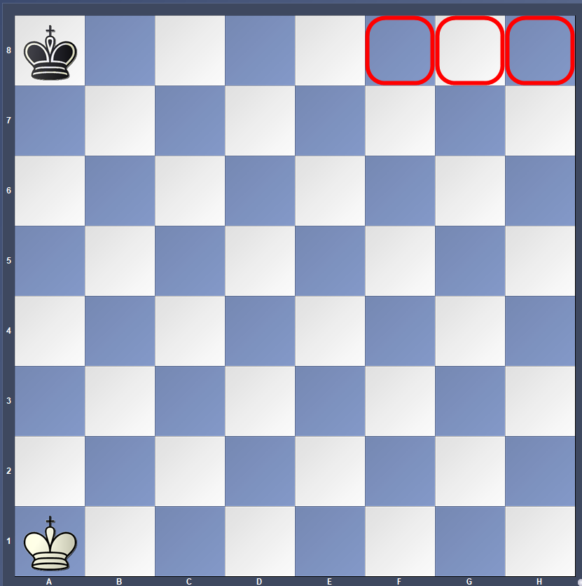
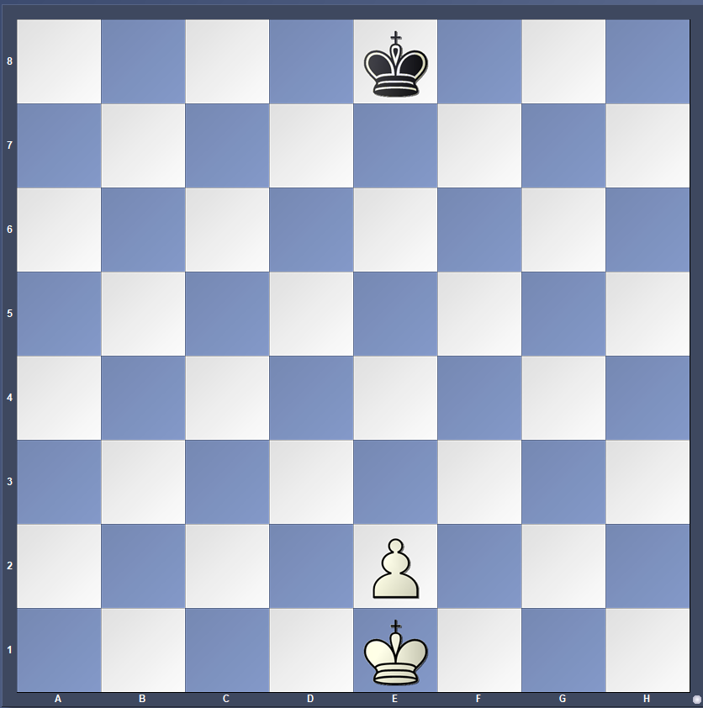
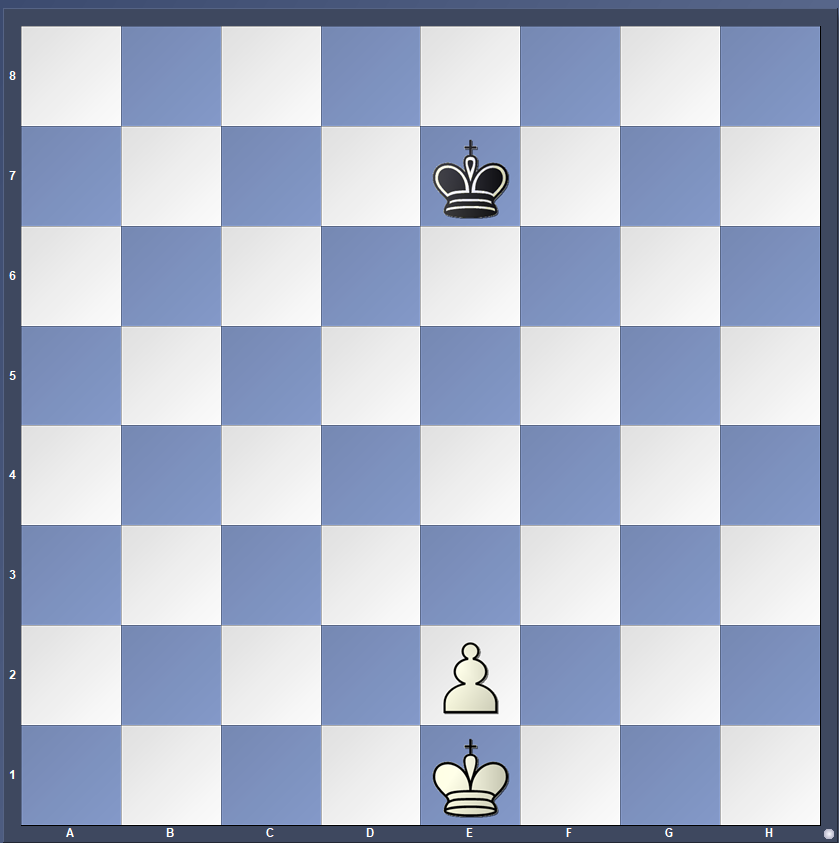
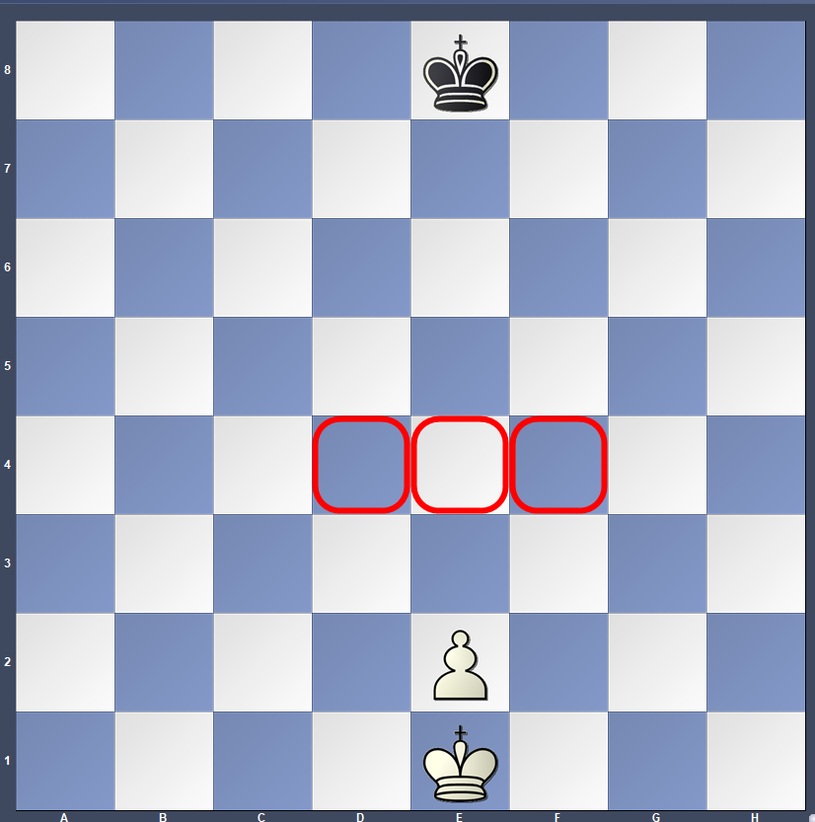
Week 1 – 2/19/24
The Button Game
Pawn Promotion1
Pawn Promotion2
Key Squares

Slide 13
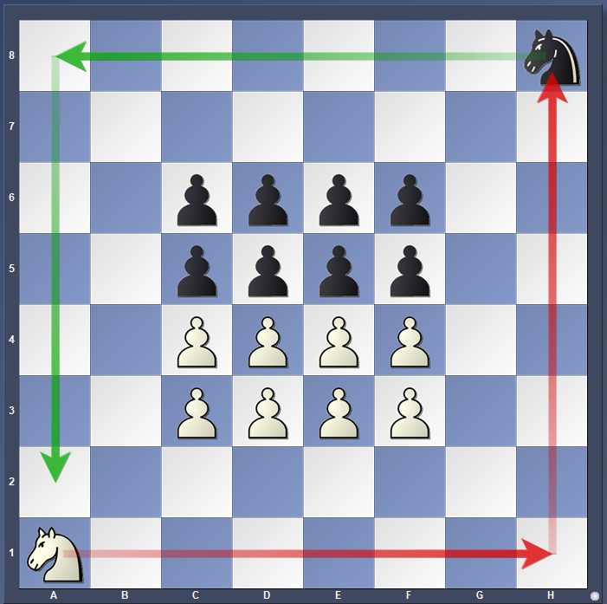
Week 1 – 2/1/24

Slide 14
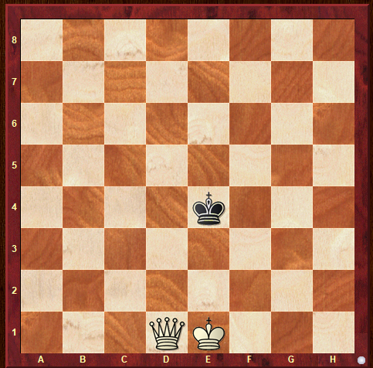
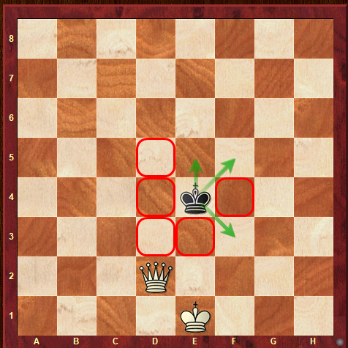
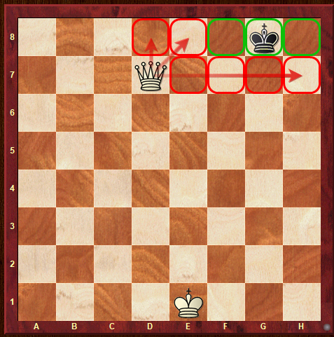
Week 1 – 2/1/24
P
Practice writing notation.
White to move. Write down all your moves and checkmate your opponent.
White’s Queen moves a Knight Jump away from the King. Notice how the Black King’s moves.
When the King is on the edge just “lock him in” and bring up your King.

Slide 15
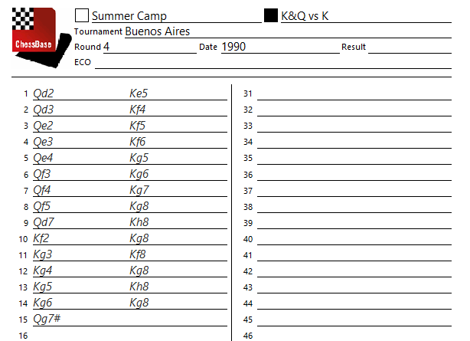
Week 1 – 2/19/24 Mate with King & Queen

Slide 16
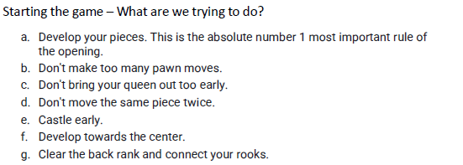
Week 1 – 2/1/24
SOME BASIC OPENING PRINCIPLES

Slide 17
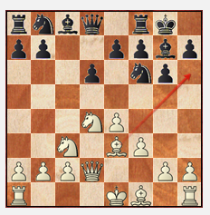
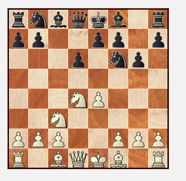
Week 1 – 2/1/24 Dragon

Slide 18
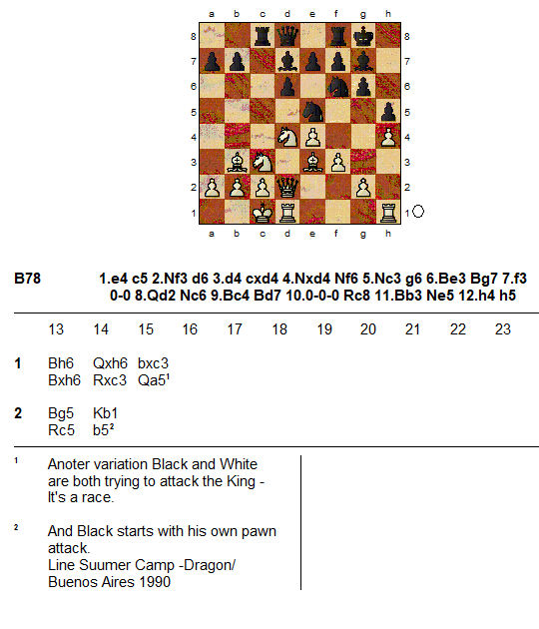
Week 1 – 2/1/24 Dragon

Slide 19
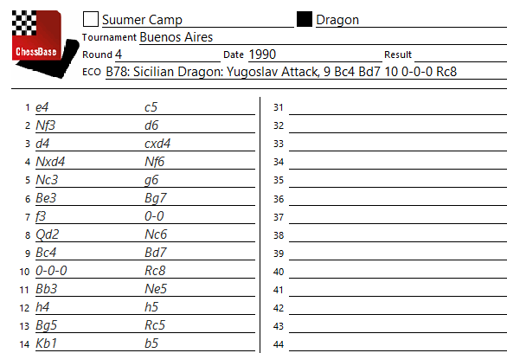
Week 1 – 2/1/24

